Slide 1

Obesity Prediction
By Gracie Inman
Notes:
Hi my name is Gracie Inman and this is my presentation for my obesity prediction project.

Slide 2
Overview of topic
Obesity is a disease that affected 1 out of 8 people in 2022 (World Health Organization, 2024).
According to the World Health Organization (2024) , obesity can also cause other negative health impacts such as:
Increased risk of type 2 diabetes and heart disease
Negatively impact bone health and reproduction
Increased risk of certain cancers
Notes:
Obesity is often calculated by the height and weight of an individual.

Slide 3
Data set and variables
Gender: Feature, Categorical, "Gender"
Age: Feature, Continuous, "Age"
Height: Feature, Continuous
Weight: Feature Continuous
family_history_with_overweight: Feature, Binary, " Has a family member suffered or suffers from overweight? "
FAVC: Feature, Binary, " Do you eat high caloric food frequently? "
FCVC: Feature, Integer, " Do you usually eat vegetables in your meals? "
NCP: Feature, Continuous, " How many main meals do you have daily? "
CAEC: Feature, Categorical, " Do you eat any food between meals? "
SMOKE: Feature, Binary, " Do you smoke? "
CH2O: Feature, Continuous, " How much water do you drink daily? "
SCC: Feature, Binary, " Do you monitor the calories you eat daily? "
FAF: Feature, Continuous, " How often do you have physical activity? "
TUE: Feature, Integer, " How much time do you use technological devices such as cell phones, video games, television, computers, and others? "
CALC: Feature, Categorical, " How often do you drink alcohol? "
MTRANS: Feature, Categorical, " Which transportation do you usually use? "
NObeyesdad: Target, Categorical, "Obesity level"
The Obesity levels dataset was obtained from Kaggle (Mehrparvar 2024).
The obesity levels dataset contains numerous variables regarding the lifestyle of the individual and their obesity level.
The dataset contains 77% simulated and 23% web-obtained data.

Slide 4
methods
Each column was visualized
The dataset was checked for missing and unique values
Categorical values were encoded
Weight and height were dropped
Data was split into training and testing
Models were trained
KNN
Naïve Bayes
Logistic regression
Random Forest
Obesity level categories were combined
Notes:
each column was visualized which allowed me to check for patterns and outliers
the dataset was checked for missing values and unique values
The unique values were used to encode the categorical variables
After performing a priliminary analysis the model was overfit. It was determined that the height and weight columns were causing the model to be overfit likely because they are used in determining obesity level

Slide 5
Results
Table 1: KNN
 | Precision | Recall | F1-score | Support
0 | 0.68 | 0.91 | 0.78 | 56
1 | 0.63 | 0.19 | 0.30 | 62
2 | 0.80 | 0.96 | 0.87 | 199
3 | 0.81 | 0.67 | 0.73 | 106
Accuracy |  |  | 0.77 | 423
Macro avg | 0.73 | 0.68 | 0.67 | 423
Weighted avg | 0.76 | 0.77 | 0.74 | 423
Table 2: Naïve Bayes
 | Precision | Recall | F1-score | Support
0 | 0.39 | 0.66 | 0.49 | 56
1 | 0.42 | 0.18 | 0.25 | 62
2 | 0.71 | 0.94 | 0.81 | 199
3 | 0.58 | 0.21 | 0.31 | 106
Accuracy |  |  | 0.61 | 423
Macro avg | 0.52 | 0.50 | 0.46 | 423
Weighted avg | 0.59 | 0.61 | 0.56 | 423
Shown to the right are the evaluation metrics for each model
Table 3: Logistic Regression
 | Precision | Recall | F1-score | Support
0 | 0.52 | 0.54 | 0.53 | 56
1 | 0.50 | 0.24 | 0.33 | 62
2 | 0.72 | 0.90 | 0.80 | 199
3 | 0.52 | 0.42 | 0.47 | 106
Accuracy |  |  | 0.64 | 423
Macro avg | 0.56 | 0.53 | 0.53 | 423
Weighted avg | 0.61 | 0.64 | 0.61 | 423
Table 4: Random Forest
 | Precision | Recall | F1-score | Support
0 | 0.95 | 0.95 | 0.95 | 56
1 | 0.71 | 0.73 | 0.72 | 62
2 | 0.91 | 0.94 | 0.93 | 199
3 | 0.86 | 0.78 | 0.82 | 106
Accuracy |  |  | 0.87 | 423
Macro avg | 0.86 | 0.85 | 0.85 | 423
Weighted avg | 0.87 | 0.87 | 0.87 | 423

Slide 6
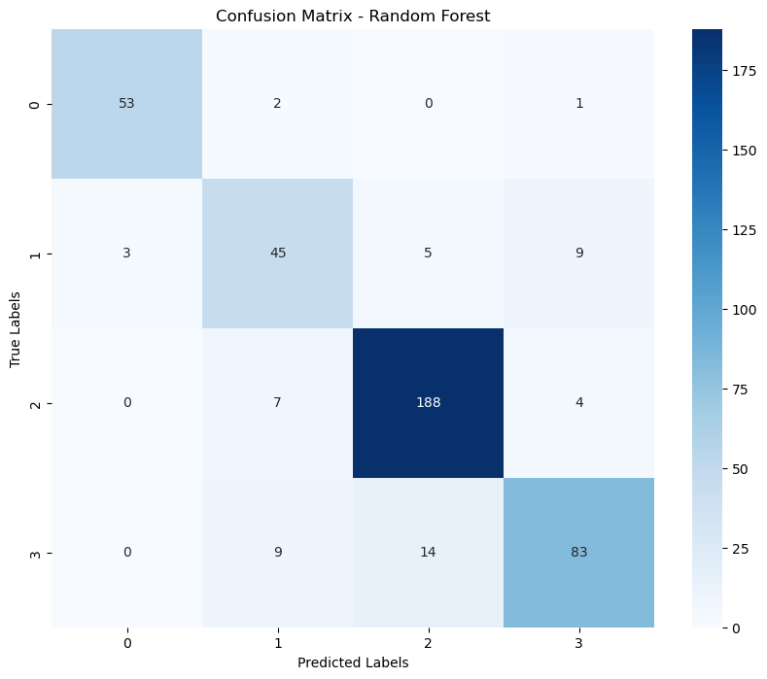
Confusion matrix
Shown to the right is the confusion matrix for the Random Forest Model
Notes:
Encoded values in 'NObeyesdad' column:[1 3 2 0]Original values:['Normal_Weight' 'Overweight' 'Obesity' 'Insufficient_Weight']

Slide 7
Summary and important considerations
Random Forest performed the best.
Limitations
Assumptions
Ethical concerns
Questions?
Notes:
Assumptions are always important to consider in each analysis. Throughout the analysis, I assumed that the generated data would accurately reflect the actual data. This could cause misrepresentation throughout the analysis. Originally, I assumed that the weight and height columns would not cause overfitting. This assumption was incorrect, and the analysis had to be redone without the weight and height columns. I also am assuming that the model will perform well on non-generated data when the model is deployed. The key assumption I am making is that someone with similar lifestyle habits can become or be in the same obesity category as someone with similar lifestyle habits.
A limitation of this dataset is that it is primarily synthetic data. This can cause the model to not perform as well on real-world data. A challenge will be obtaining a substantial amount of real-world data to test and optimize the model.
For the model to be implemented, the data should be tested on unseen real-world data. This could be obtained through surveys. Once tested and optimized, it could be incorporated into the customer targeting systems or used to create a risk assessment quiz.
Ethical concerns are always something that needs to be considered. One concern is this is health-related data. With health-related data, there is always a concern about privacy and confidentiality as informed consent. There were no names or identifying information linked to individual cases which reduces the confidentiality concerns with this data. I am also concerned about possible bias towards individuals labeled as obese by this model.
Why did the data contain synthetic data?
The data likely contained synthetic data because there wasn’t enough internet data to perform a large analysis.
When you say risk assessment quiz what do you mean?
By using the data and having people pick their lifestyle habits, it can determine which weight category they are likely to fall into now or in the future
How did you know height and weight were causing the model to be overfit?
I checked feature importance, and I had a hunch because that is what is used to calculate BMI.
How would you go about getting additional real-world data?
The most likely source would be to conduct an anonymous survey.
Why did you combine the obesity variables into one?
For this study, I did not feel as though all of the additional weight categories were necessary.
Which model did you think would perform the best?
I thought KNN would perform the best
Why did you encode the variables?
This is necessary to ensure the optimal performance of models
You mention privacy concerns as a possible ethics issue. Can you elaborate on why you are and are not concerned?
I am not concerned because there is no identifying information in any of the data. In addition, 77% of the data is synthetic and not obtained from health records or survey data.
Why did you remove height and weight and not just weight?
Both played a role in BMI, and I felt after removing weight the model was still overfit.
Can you explain why there were more cases of obesity correctly identified in the confusion matrix?
This is likely due to the fact that there were more cases of obesity located in the dataset.

Slide 8
references
Centers for Disease Control and Prevention. (2022, May 17). Adult obesity facts. Centers for Disease Control and Prevention. https://www.cdc.gov/obesity/data/adult.html
Mehrparvar, F. (2024, April 7). Obesity levels. Kaggle. https://www.kaggle.com/datasets/fatemehmehrparvar/obesity-levels
World Health Organization. (2024, March 1). Obesity and overweight. World Health Organization. https://www.who.int/news-room/fact-sheets/detail/obesity-and-overweight#:~:text=Overview,the%20risk%20of%20certain%20cancers.

